Slide 1
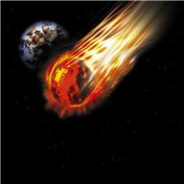
ENGLISH TOMATO,3014
IN THE YEAR 3014, A BIG TOMATO NAMED ENGLISH TRAVELS AROUND AN UNKNOWN GALAXY NAMED ONION

Slide 2
SUDDENLY A BIG ONION APPEARS AND ASKS HIM «WHAT ARE YOU DOING HERE IN MY GALAXY? THIS GALAXY IS ONLY FOR ONIONS, NOT FOR TOMATOES»
ENGLISH TOMATO REPLIES «DON’T MESS WITH ME, I’M BIGGER THAN YOU AND I CAN SLIDE YOU IN MANY PIECES»

Slide 3
A LETTUCE WATCHING THE SITUATION SAYS «WE CAN LIVE TOGETHER IN THE SAME GALAXY AND MIX FOR A SALAD»

