Slide 1
MY PET PAKITA

Slide 2
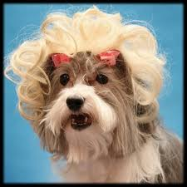

Slide 3
I HAD A LITTLE FEMALE DOG, CALLED PAKITA, FRENCHPOODLE WAS HER BREED, SHE WAS SMALL, FURRY AND WHITE COLOR, SHE WAS VERY PLAYFUL AND TENDER, I LOVED MY DOG BECAUSE SHE WAS VERY SPECIAL WITH ME

Slide 5
ONE DAY WE WENT TO MY AUNT`S FARM AND PAKITA AND I WENT OUT FOR A WALK, ONCE WE GOT IN THE FOREST PAKITA RAN AND STARTED BARKING ALOUD, SUDDENLY A PItBUll APPEARED AND BIT PAKITA IN THE NECK. I GOT IN PANICK WHEN I SAW HER LOOKING AT ME LIKE ASKING FOR HELP. I THREW IT PIECES OF STICKS AND ROCKS AND THE DOG DIDN`T OBBEY ME, AND KILLED HER. POOR PAKITA, MY LITTLE FEMALE DOG DIED.

Slide 6
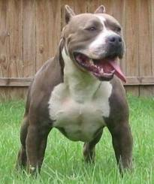

Slide 7
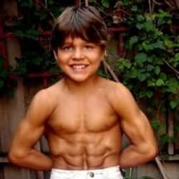
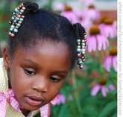
WRITTEN BY:
ELKIN MORENO
AMARILIS RAMOS
JUSTINA VELEZ

