Slide 1
The teacher´s pet

Slide 2
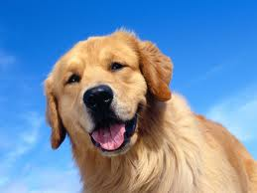
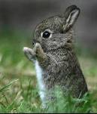
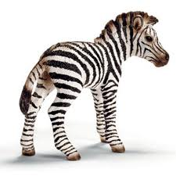
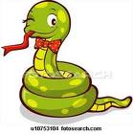
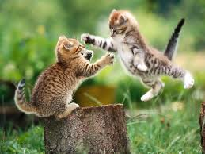
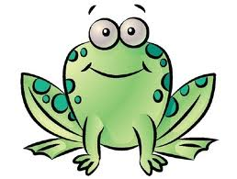
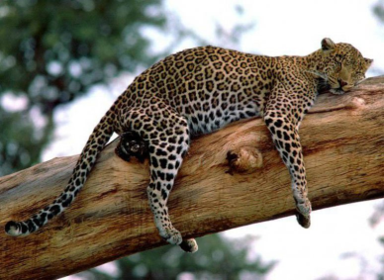
-
“Good morning everybody” said the wise Teacher dog Carito.
“Good morning Teacher”, said the students.

Slide 3
The teacher asks Pipo to collect homework but some students start to complain about it.

Slide 5
Don’t be envious, he helps you every time you need him, he does your homework, too.
Kathy the zebra said:

Slide 6
“Stop it, I´m very sad because of this situation” said the teacher, “you must understand you all are good for me”.

Slide 7
“Frika remember that you help me when you want to do it, but you use to be in a bad mood.”
Teacher “Everybody has a function in this class and I love when you help me because in this way things can be done better”.

Slide 8
“I just use some help from those students who finish the activities without any trouble so I can be working out with those who needs me more. And all of you are quite intelligent”,

Slide 9
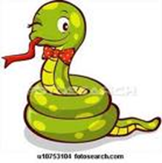
Pipo smile at Frika and said “You should give me a hand collecting homework”.
Frika smile back and that was the last day he bother at Pipo the smart and responsible froggy.

