Slide 1
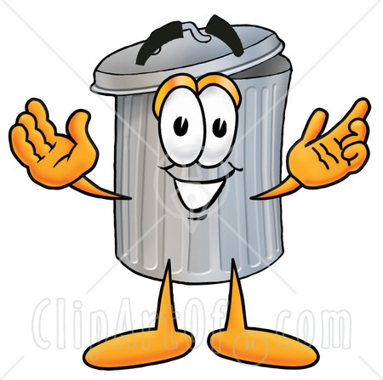
Mr. Garbage Authors: Sandra Gutierrez Edward Cano Elkin Garrido

Slide 2
Mr. Garbage was the most
beautiful basket at school.

Slide 3
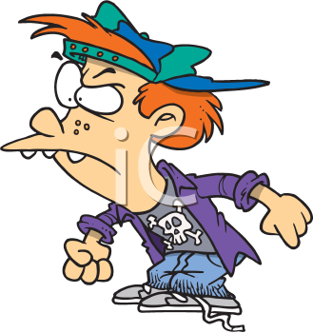
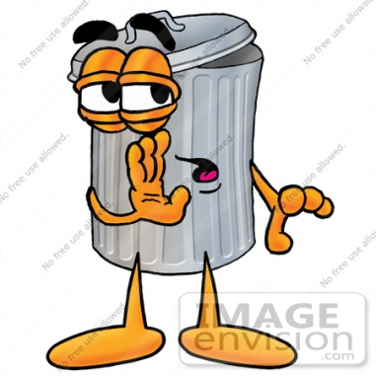
But children did not love him because he used to tell them, they should throw the garbage inside him.

Slide 4
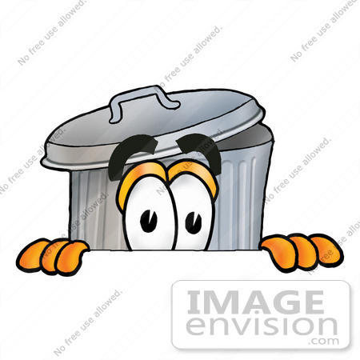
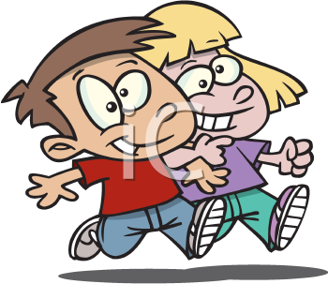
One day the children bullied him and he felt very sad.

Slide 5
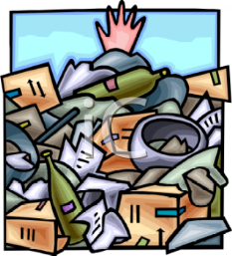
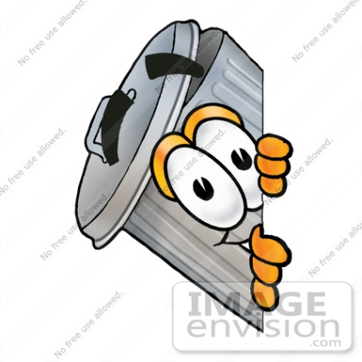
The next day, they threw garbage around the playground while he was seeing them.

Slide 6
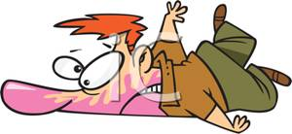
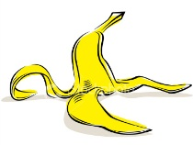
Suddenly, one child fell down because he stepped a banana skin and hurted his head.
So, he was taken to the hospital and The children remembered Mr. Garbage’s advices

Slide 7
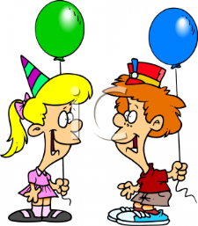
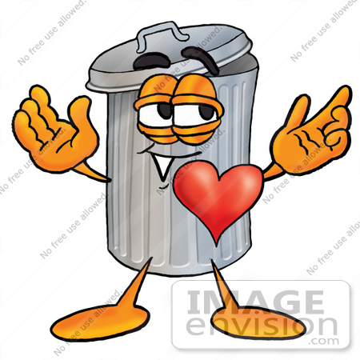
From that day, nobody throws garbage on the ground, they throw it inside Mr. Garbage and everybody loves him.
End

